Slide 1


2D Visualization with the ArcGIS API for JavaScript
Kristian Ekenes & Jeremy Bartley
Notes:
Esri Corporate Template-Dark v3.3
16:9 version – January 21, 2016
For more templates, sample files, and icons, see https://compass.esri.com/resources/presentations/Pages/Main.aspx
To add footer text in Windows
On the Home tab, under Insert, click Text, and then click Header and Footer.
Click the Slide tab, select the Footer check box, and then type the footer text that you want.
Click either Apply or Apply to All.
To add footer text on a Mac
On the View menu, select Header and Footer.
Select the Footer check box and then type the footer text that you want.
Click either Apply or Apply to All.
If footers don't appear on the slides
If footers don't appear on title slides, in the Header and Footer dialog box make sure the Don't show on title slide check box is not selected.
If the footers are missing from other slides, the placeholders for these items might have been removed from specific slide layouts or the slide master.

Slide 2
Visualization in 4.x is not at parity with 3.x versions of the API
3.x
only
Indicates feature is only supported in 3.x as of current release (4.3)
4.x
partial
Indicates partial 4.x support as of current release (4.3)

Slide 3
Feature Layer
Your gateway to client-side visualization

Slide 4
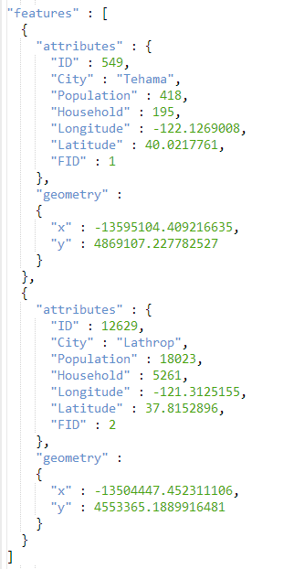
Feature Layer
Vector data (svg or canvas)

Slide 5
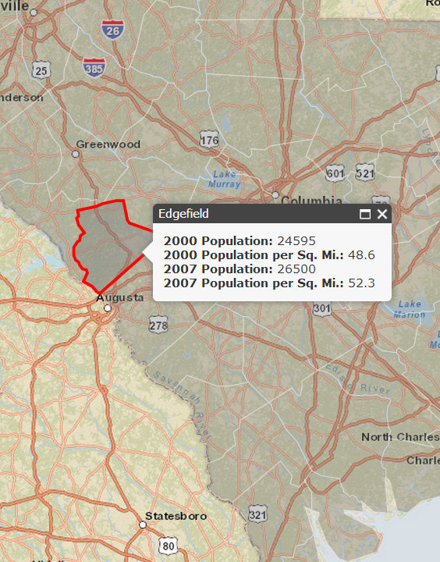
Feature Layer
Vector data (svg or canvas)
Interactive
Popups

Slide 6
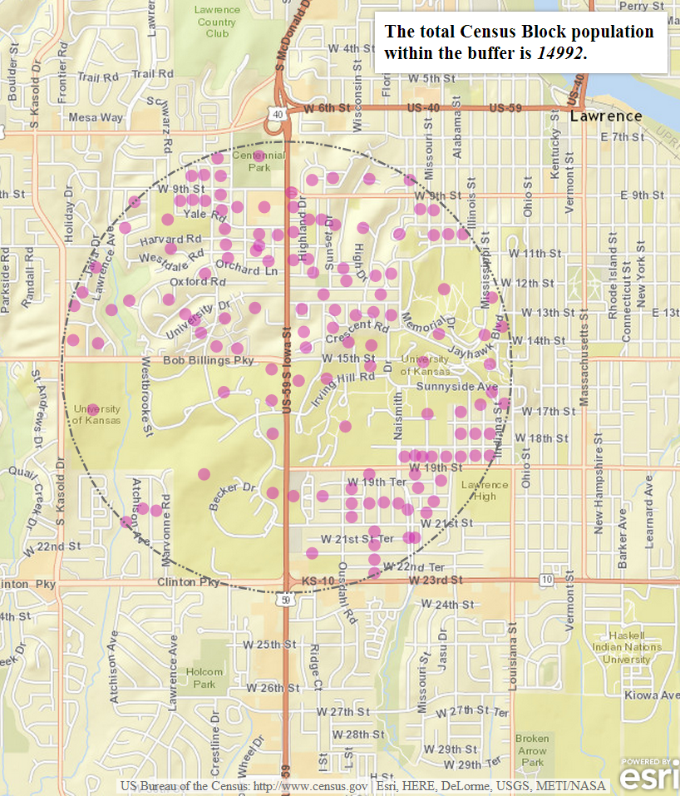
Feature Layer
Vector data (svg or canvas)
Interactive
Popups
Query (spatial and attribute)

Slide 7
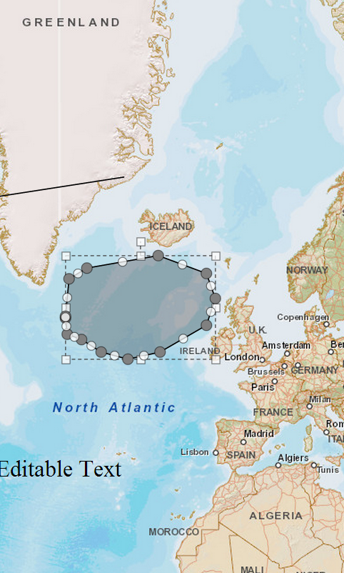
Feature Layer
Vector data (svg or canvas)
Interactive
Popups
Query (spatial and attribute)
Enables editing

Slide 8
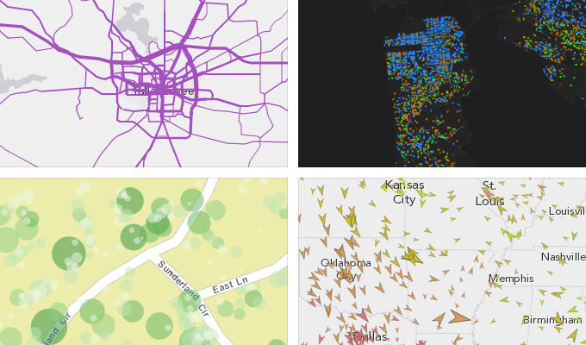
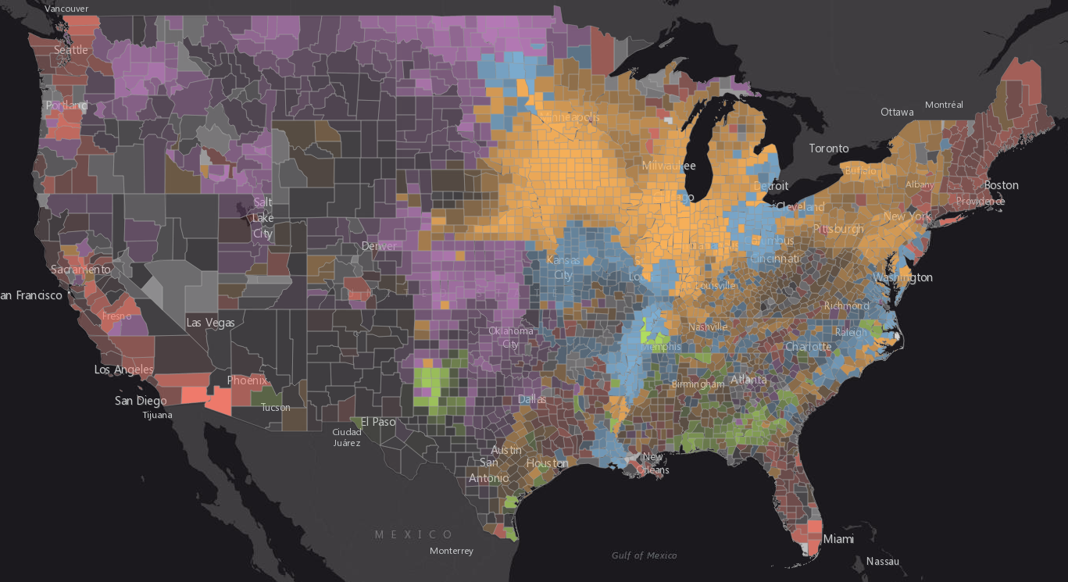
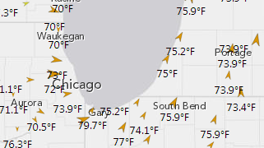
Various Ways to Visualize a Feature Layer
And More!

Slide 9
Renderers
SimpleRenderer
UniqueValueRenderer
ClassBreaksRenderer

Slide 10
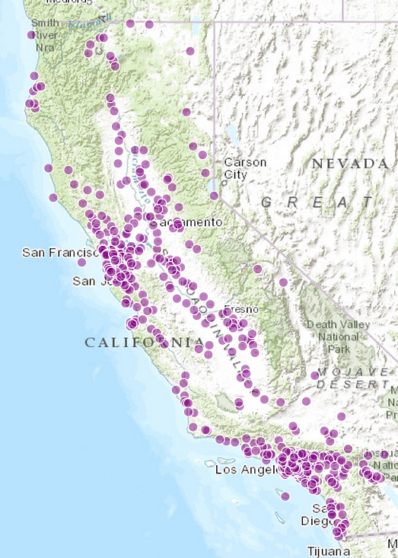
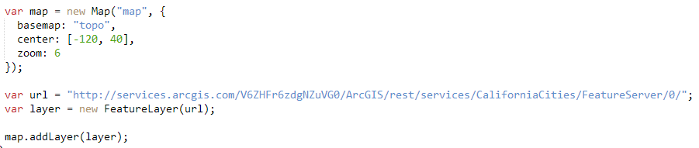
Default Feature Layer View
A feature layer has its own default symbol
Defined in the “drawingInfo” property

Slide 11
Show me where!
Single symbol, no field

Slide 12
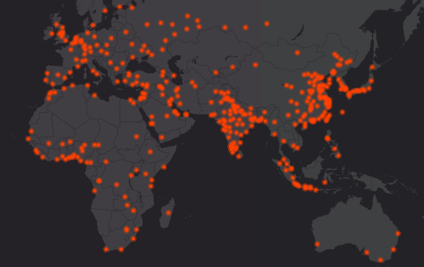
Show me where! (no field)
Simple Renderer

Slide 13
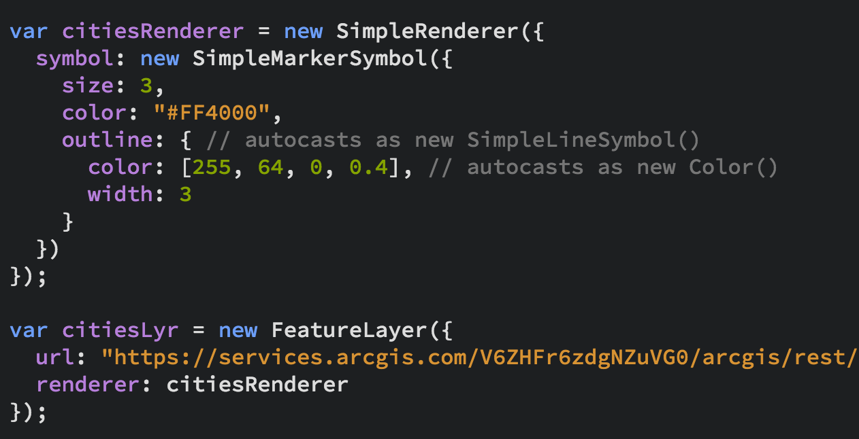
Show me where! (no field)
Simple Renderer

Slide 14
Show me what!
Based on field or expression

Slide 15
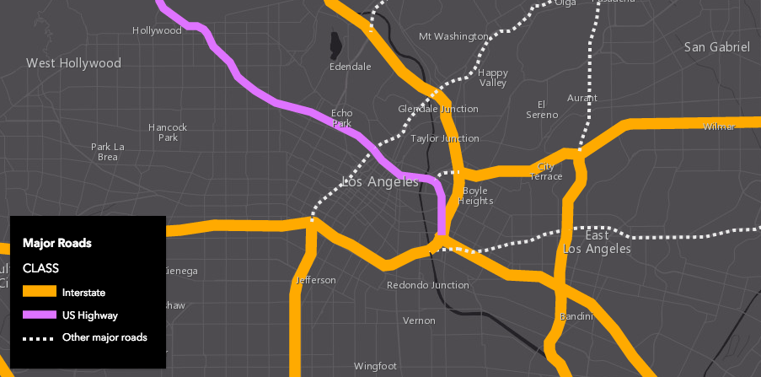
Show me what! (with field)
Unique Value Renderer

Slide 16
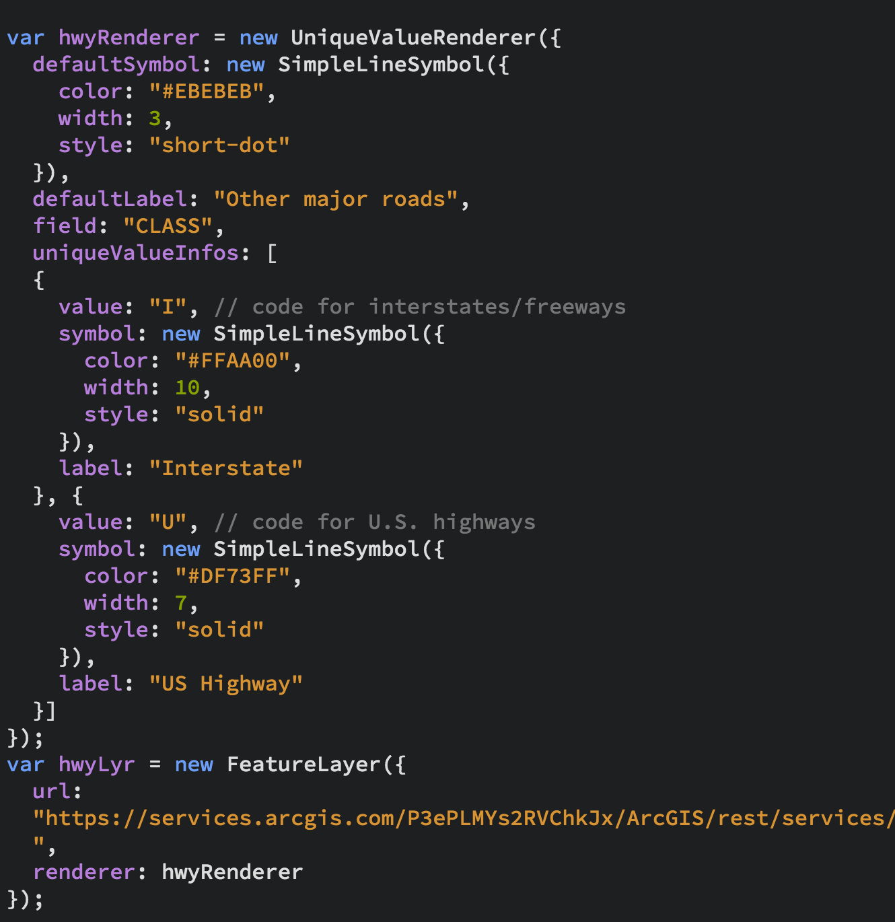
Show me what! (with field)
Unique Value Renderer

Slide 17
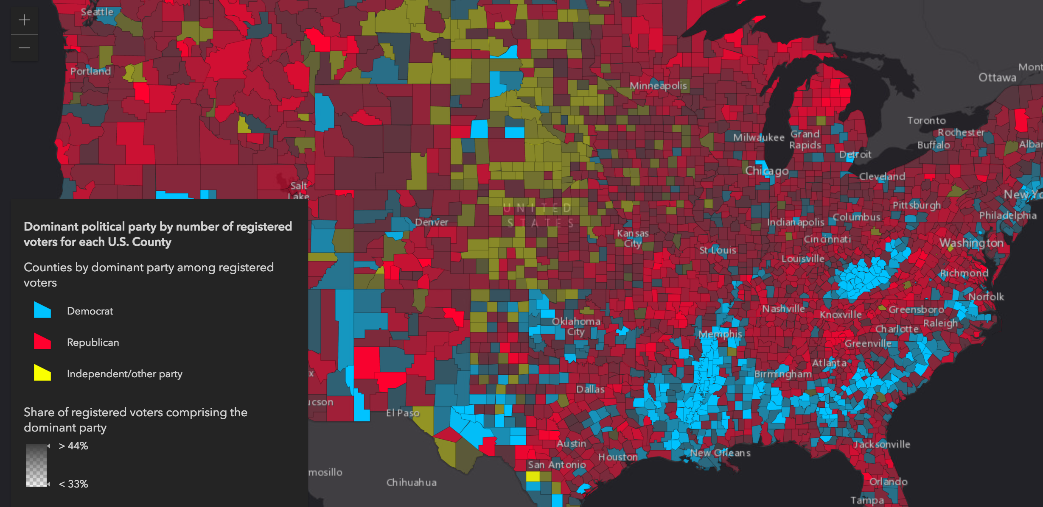
Show me what! (with Arcade expression)
UniqueValueRenderer + Opacity visual variable

Slide 18
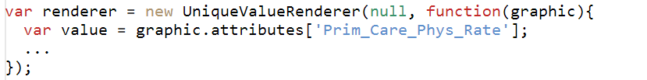
Show me what! (with JS expression function)

Slide 19
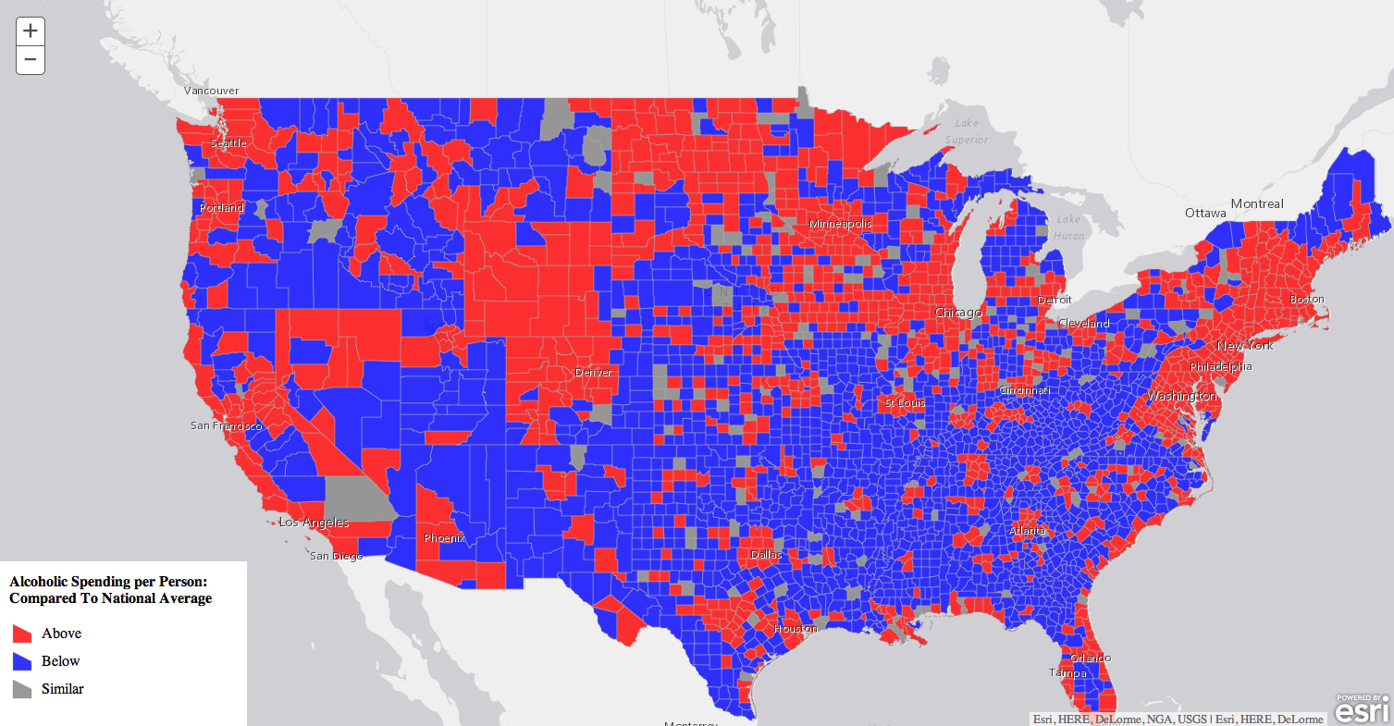
Show me what! (with JS expression function)– Above and Below

Slide 20
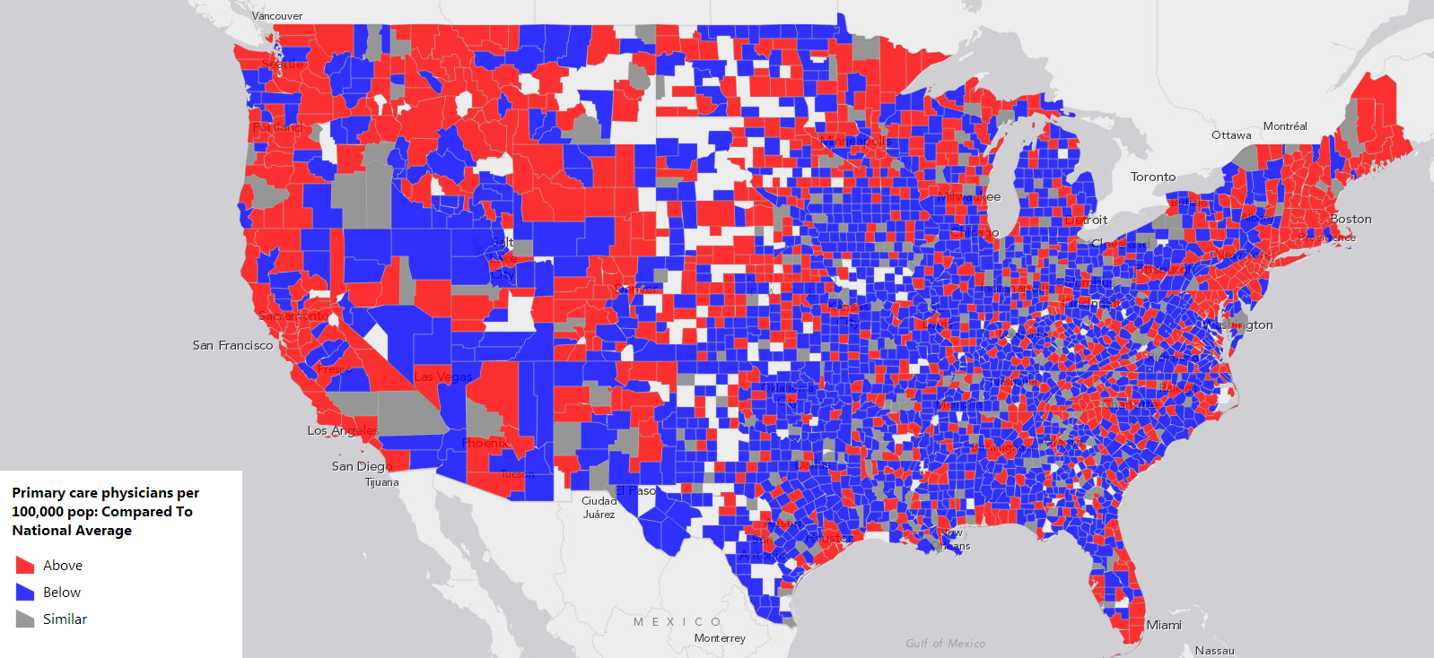
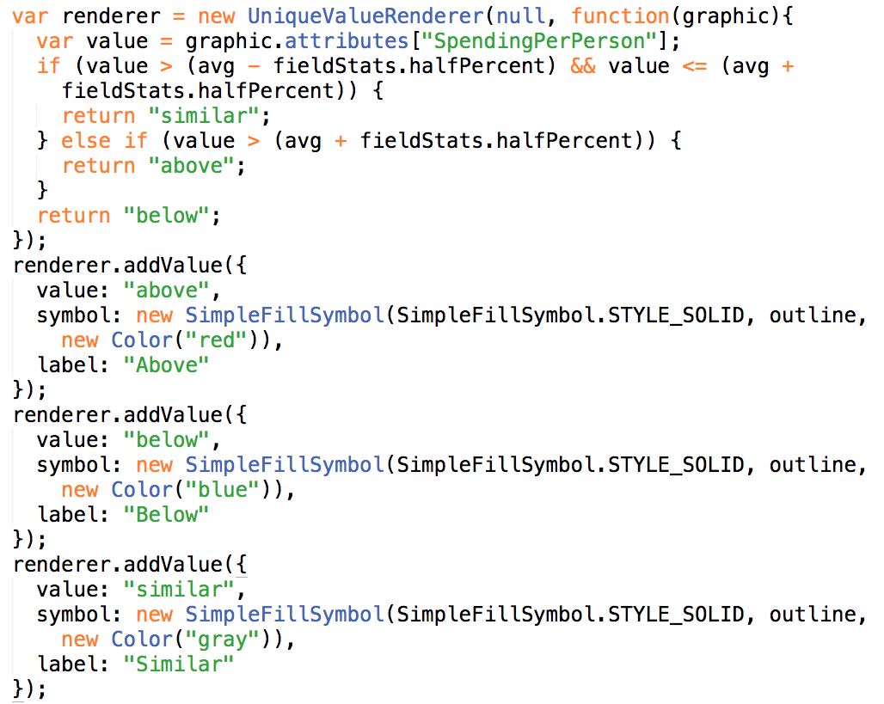
Show me what! (with JS expression function)– Above and Below

Slide 21
Show me how much!
Color
Size
Opacity
Also based off field value or expression

Slide 22
Parametric Properties on Renderer
rotation
size
color
opacity
VisualVariables – Parameterized Symbols
Notes:
Does this still belong????

Slide 23
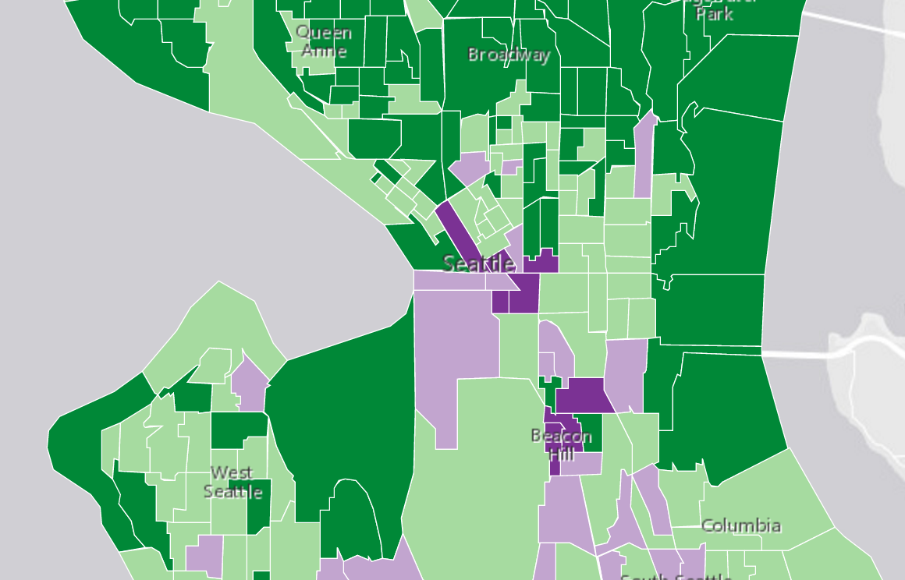
Show me how much! (classed color)
Class Breaks Renderer

Slide 24
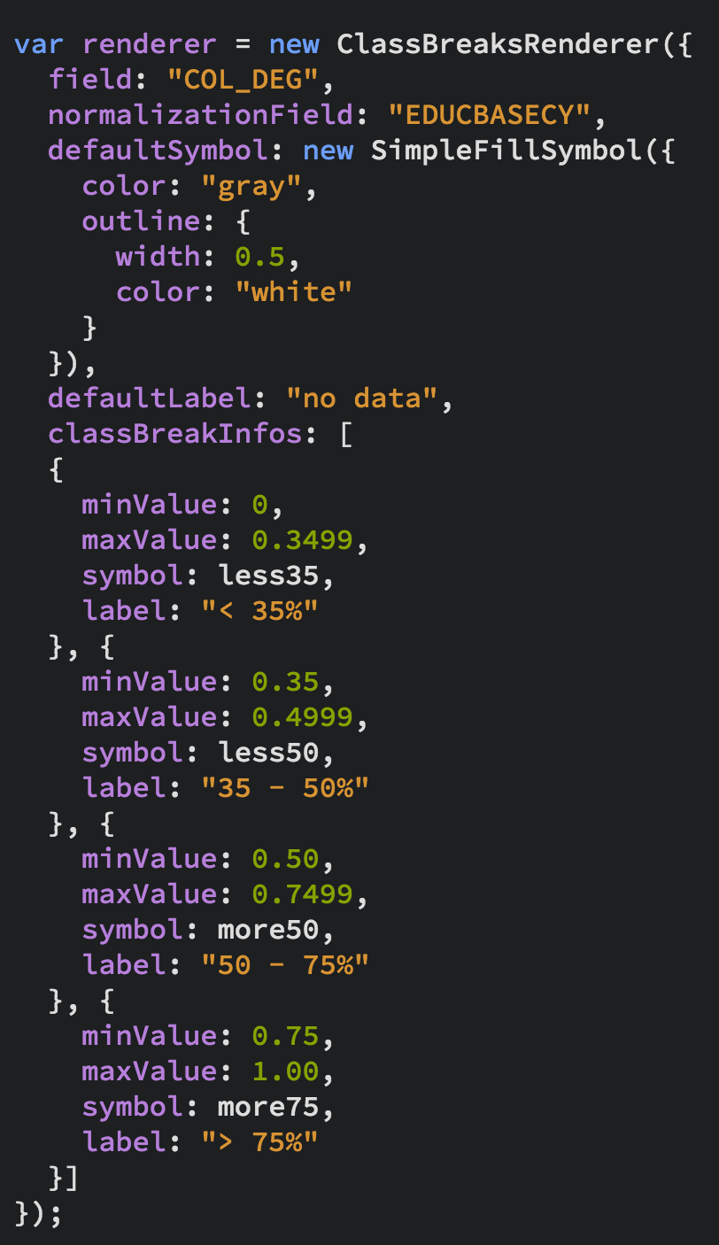
Show me how much! (classed color)
Class Breaks Renderer

Slide 25
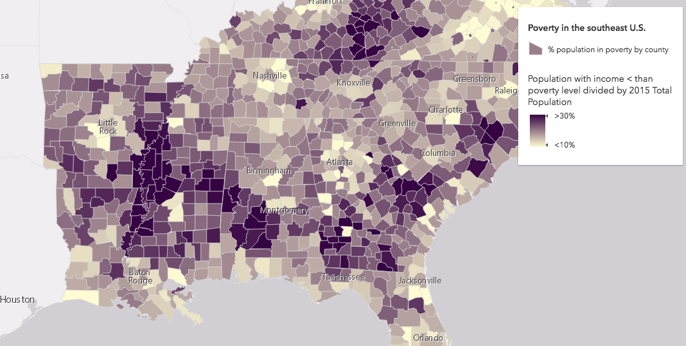
Show me how much! (continuous color)
SimpleRenderer + color visual variable

Slide 26
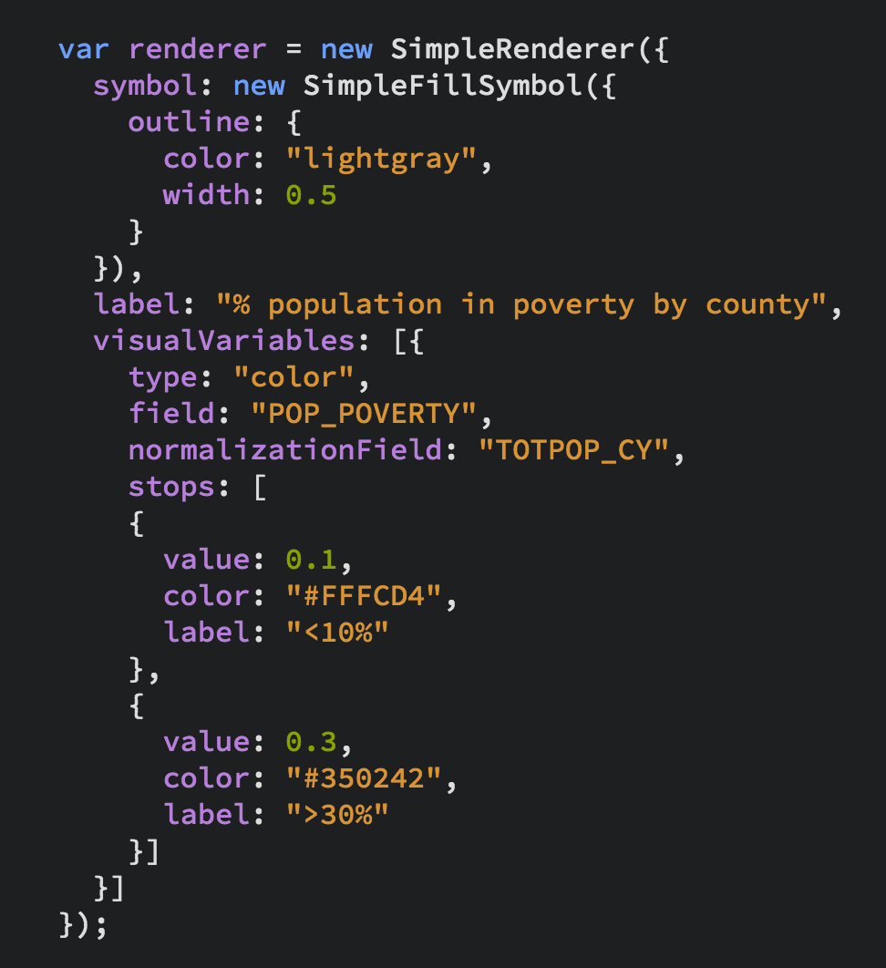
Show me how much! (continuous color)
SimpleRenderer + color visual variable

Slide 27
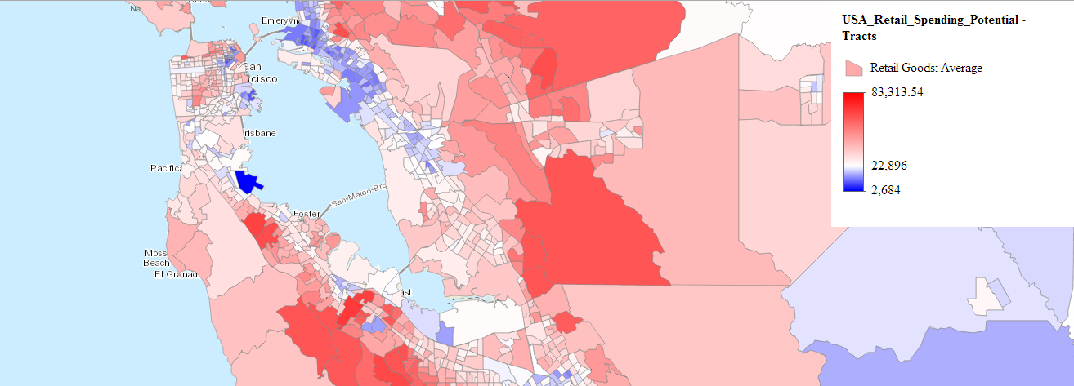
Show me how much! (color with stops)
SimpleRenderer + colorInfo

Slide 28
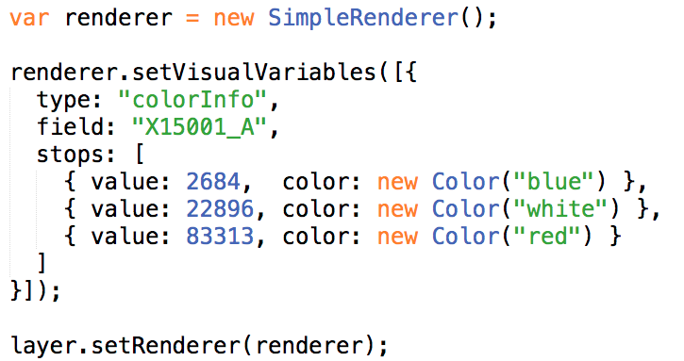
Show me how much! (color with stops)
SimpleRenderer + colorInfo
Notes:
http://servicesbeta.esri.com/jerome/uc2014/newprop-color-stops-interactive.html

Slide 29
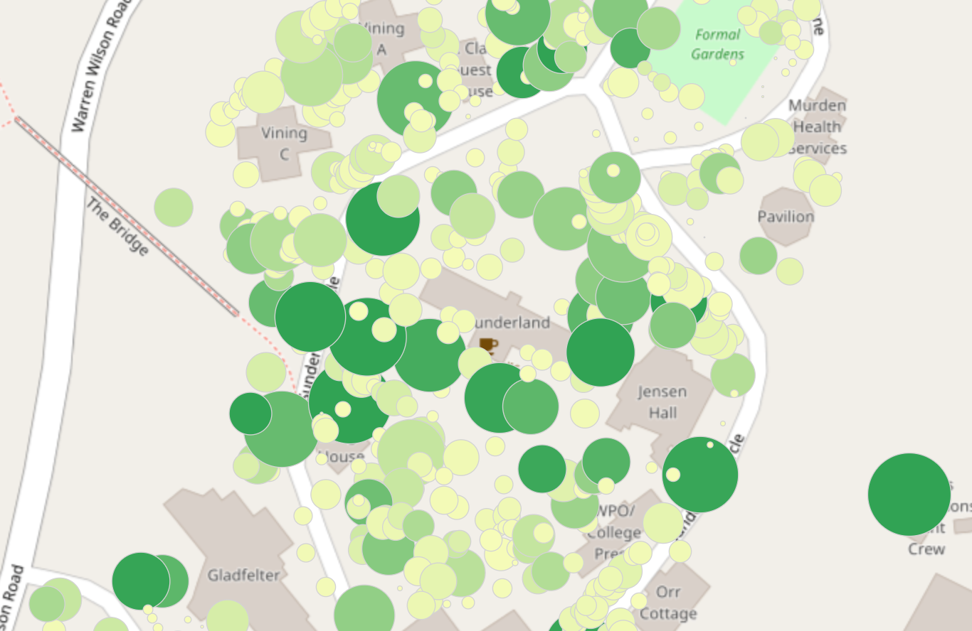
Show me how much! (size by real-world dist./area)
SimpleRenderer + size visual variable

Slide 30
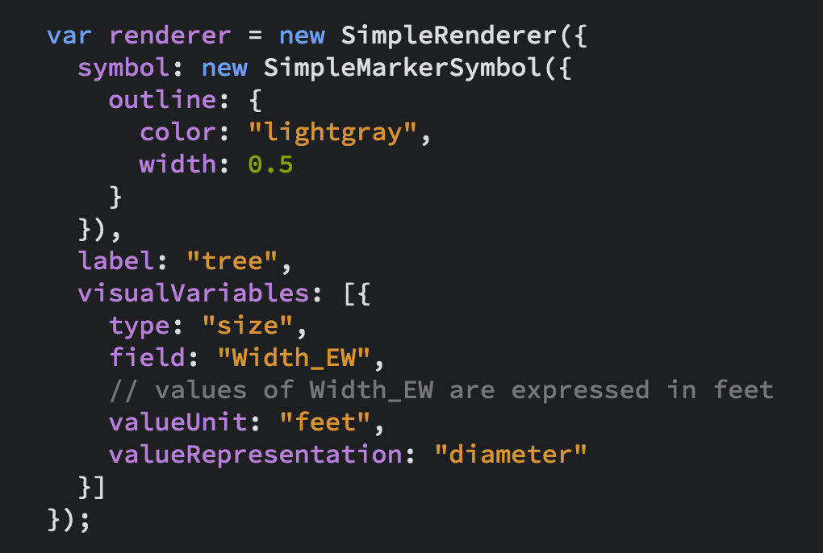
Show me how much! (size by real-world dist./area)
SimpleRenderer + size visual variable

Slide 31
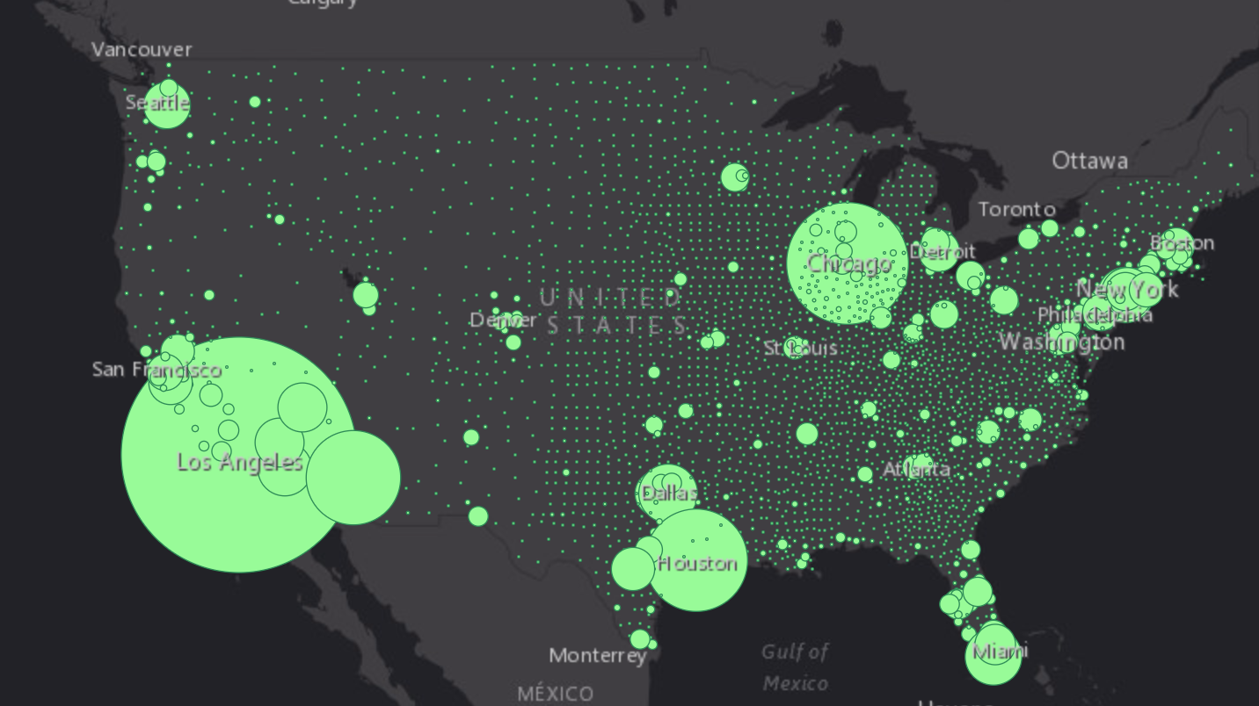
Show me how much! (truly proportional size)
SimpleRenderer + Size visual variable

Slide 32
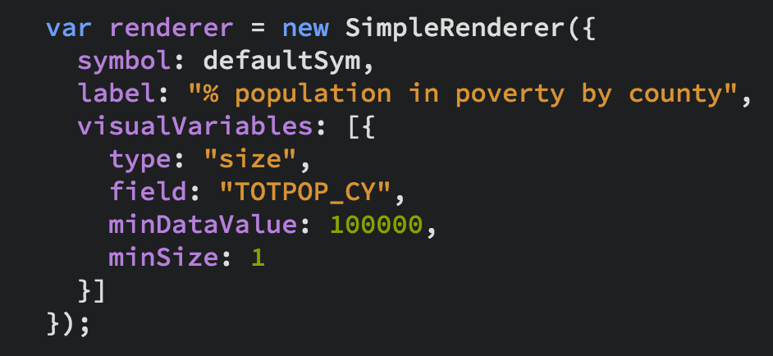
Show me how much! (truly proportional size)
SimpleRenderer + Size visual variable

Slide 33
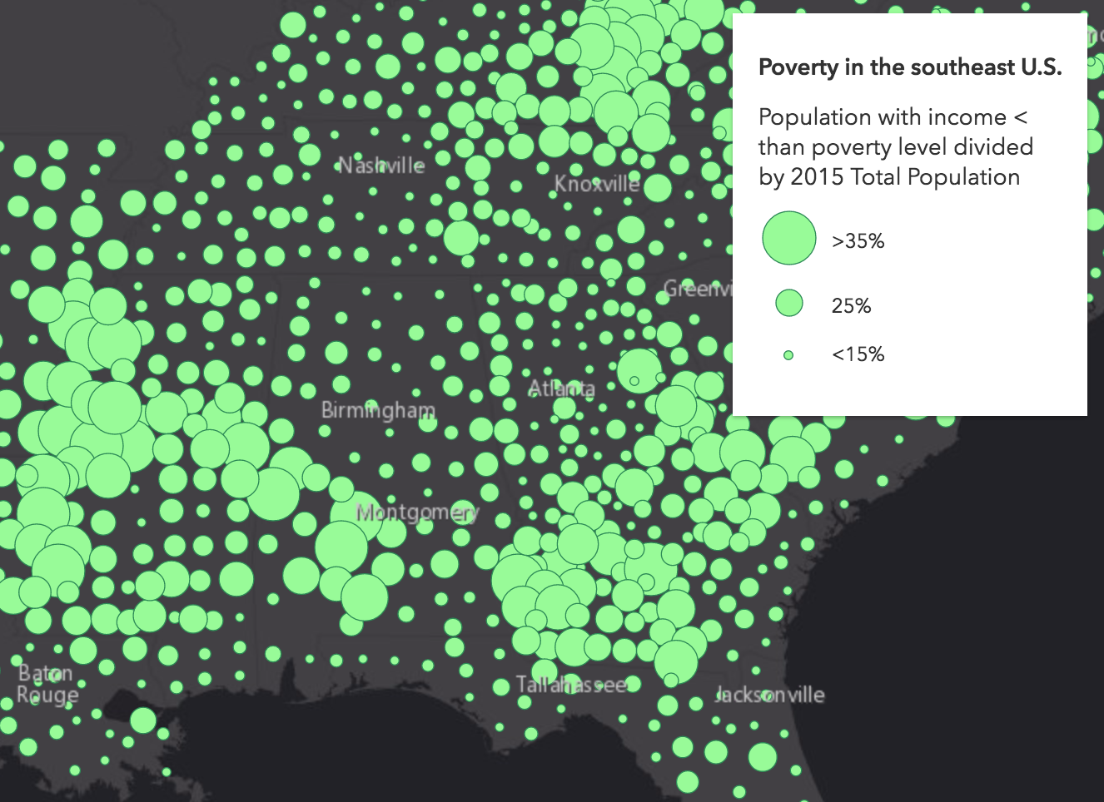
Show me how much! (continuous size - bounded)
SimpleRenderer + Size visual variable

Slide 34
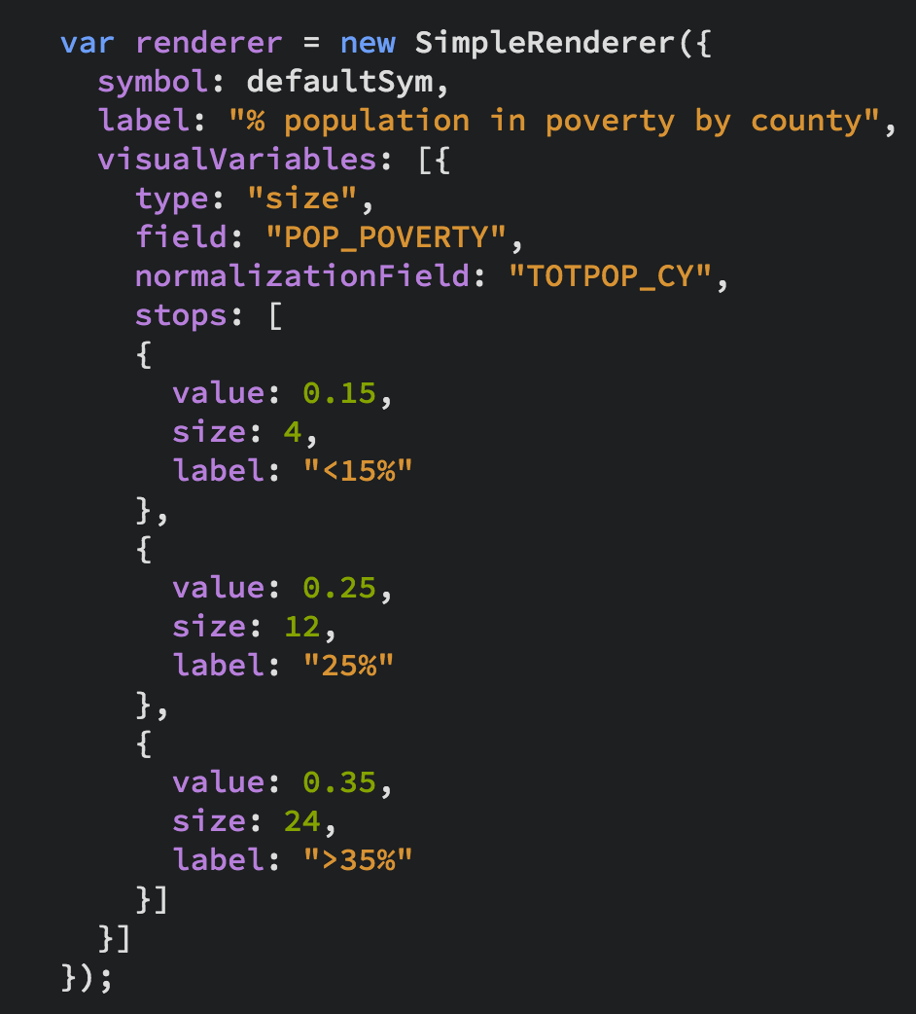
Show me how much! (continuous size - bounded)
SimpleRenderer + Size visual variable

Slide 35
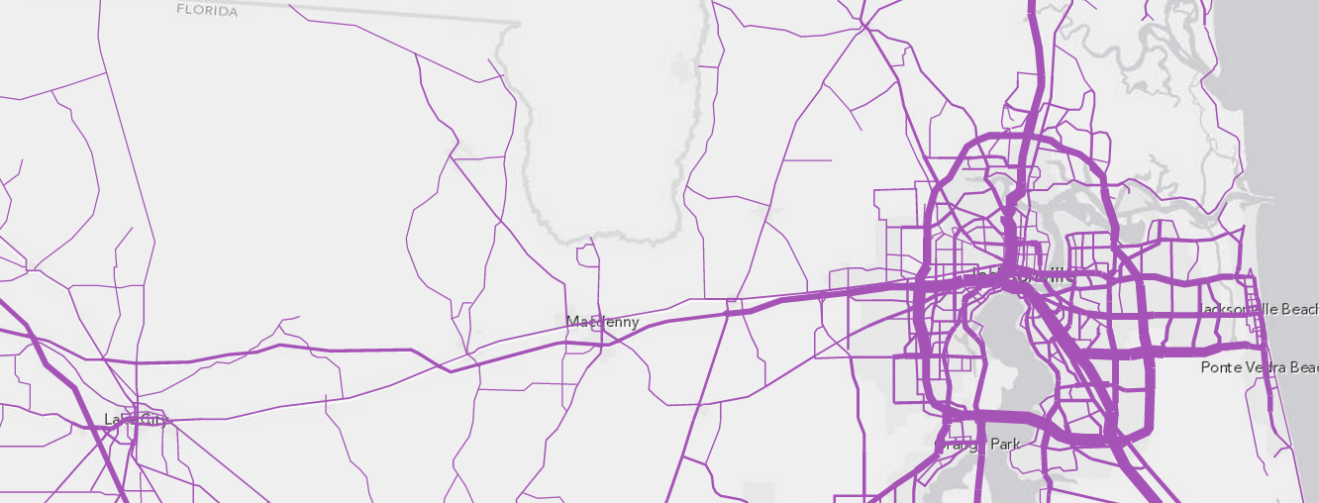
Show me how much! (bounded proportional size)
SimpleRenderer + Size visual variable
Notes:
http://developers.arcgis.com/javascript/samples/renderer_proportional_lines
http://jyang.esri.com/samples/draw-layer/proportional-slider2.html
http://developers.arcgis.com/javascript/samples/renderer_graduated_polygon/

Slide 36
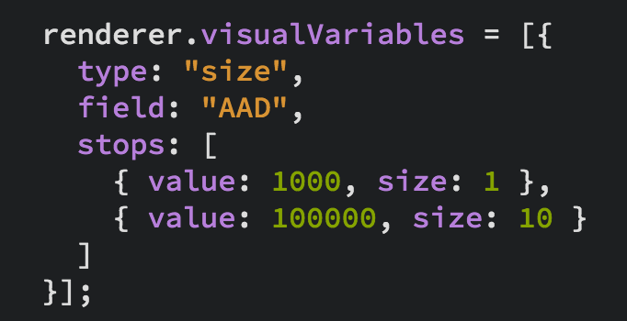
Show me how much! (bounded proportional size)
SimpleRenderer + Size visual variable
Notes:
http://developers.arcgis.com/javascript/samples/renderer_proportional_lines
http://jyang.esri.com/samples/draw-layer/proportional-slider2.html
http://developers.arcgis.com/javascript/samples/renderer_graduated_polygon/

Slide 37
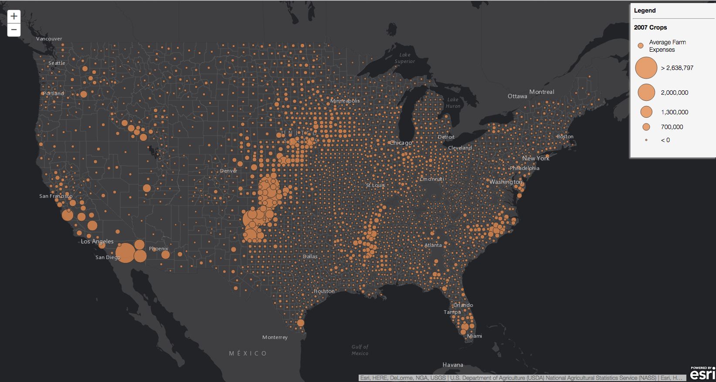
Show me how much! (scale dependent continuous size)
SimpleRenderer + Size visual variable
Map should look
good at all scales

Slide 38
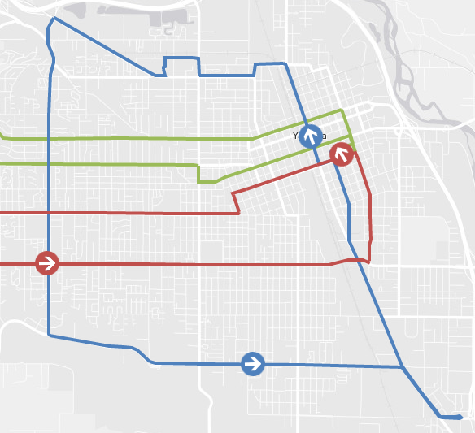
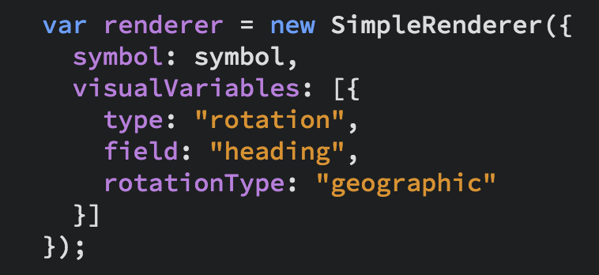
Rotation
Renderer + rotation visual variable

Slide 39
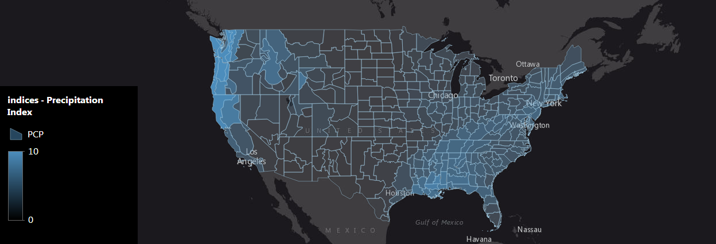
Show me how much! (continuous opacity)
SimpleRenderer + Opacity visual variable

Slide 40
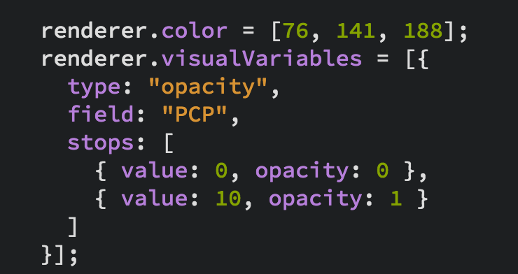
Show me how much! (continuous opacity)
SimpleRenderer + Opacity visual variable

Slide 41
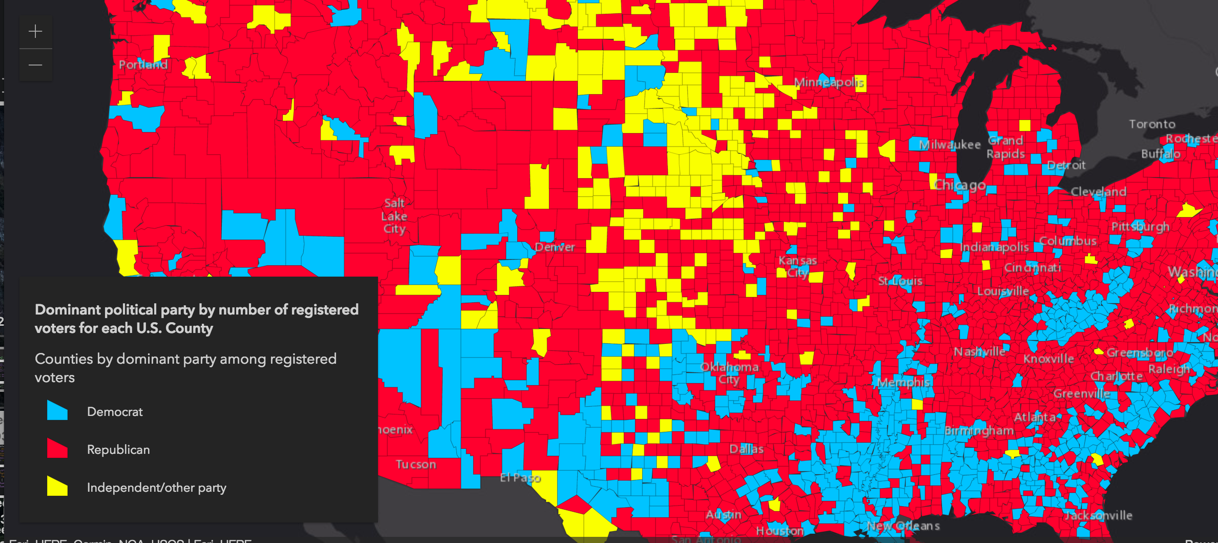
Show me how much! (continuous opacity)
UniqueValueRenderer + Opacity visual variable
Notes:
[Show live sample of this one]
Show map and describe (go to the app)
Show popup for one crop, popup for another crop
Show code sample (next page)

Slide 42
Show me how much! (continuous opacity)
UniqueValueRenderer + Opacity visual variable

Slide 43
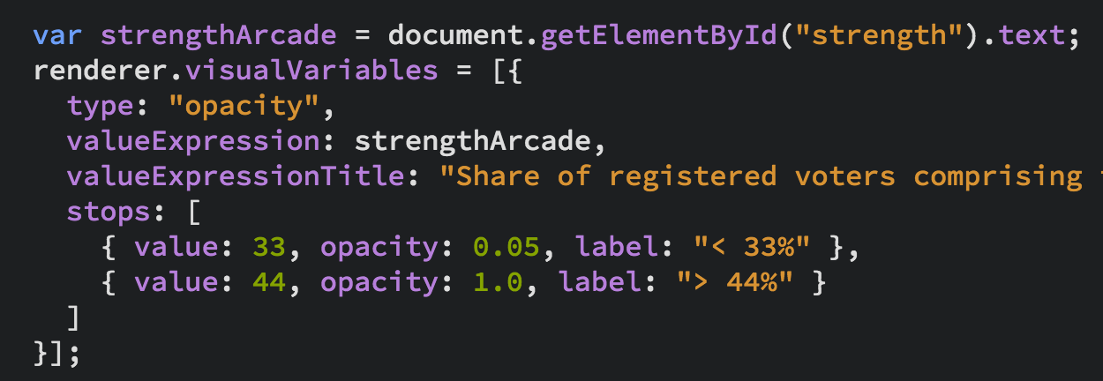
Show me how much! (continuous opacity)
UniqueValueRenderer + Opacity visual variable

Slide 44
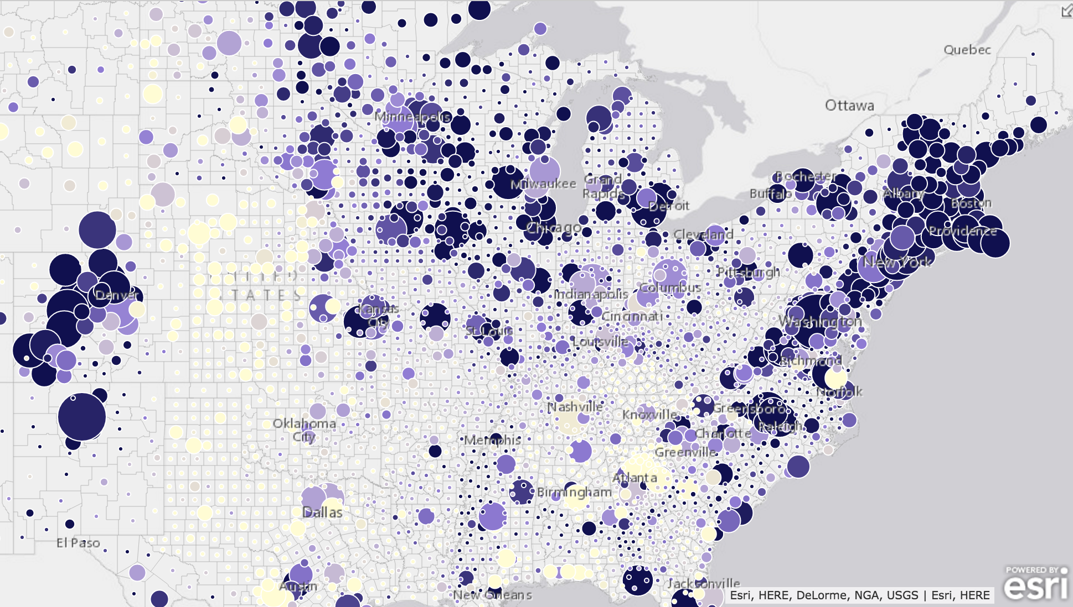
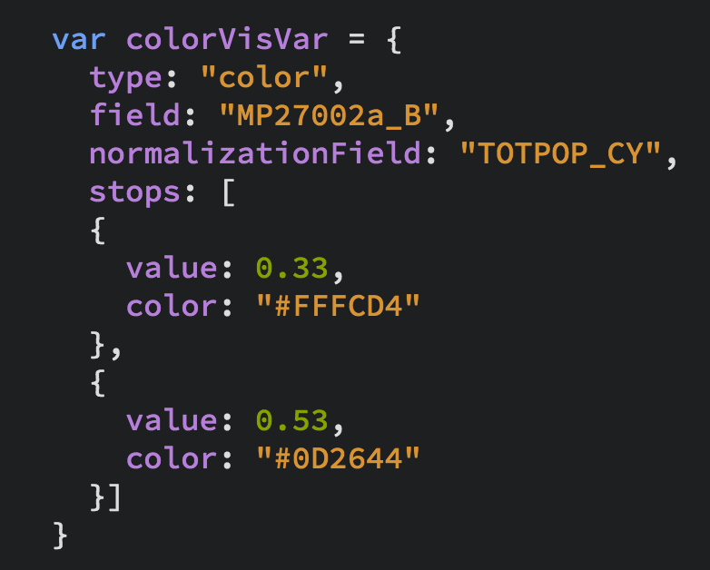
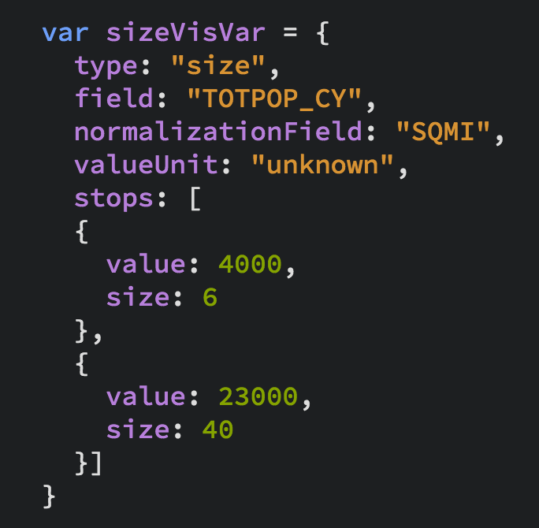
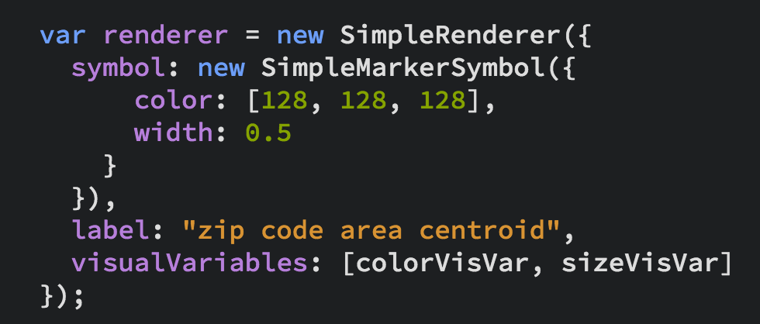
Show me potential correlation
Color + size visual variables to visualize two variables

Slide 45
Show me when
Timeline with start and end date field (continuous color)
Timeline before and after date field (diverging continuous colors)

Slide 46

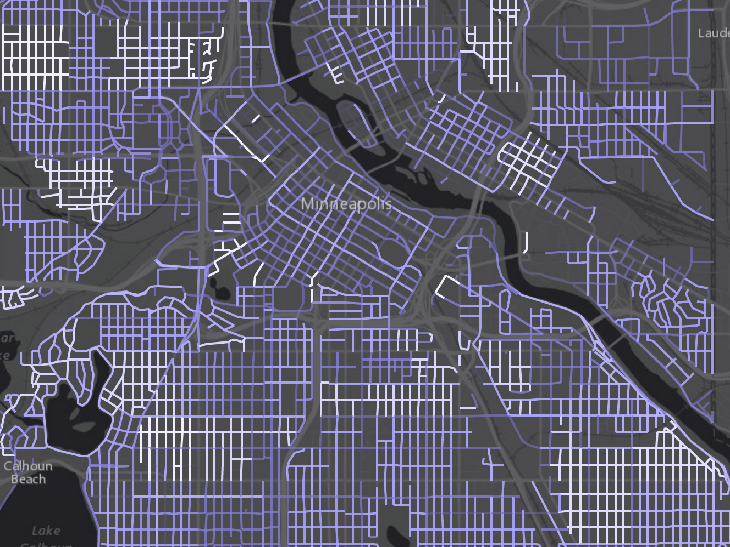
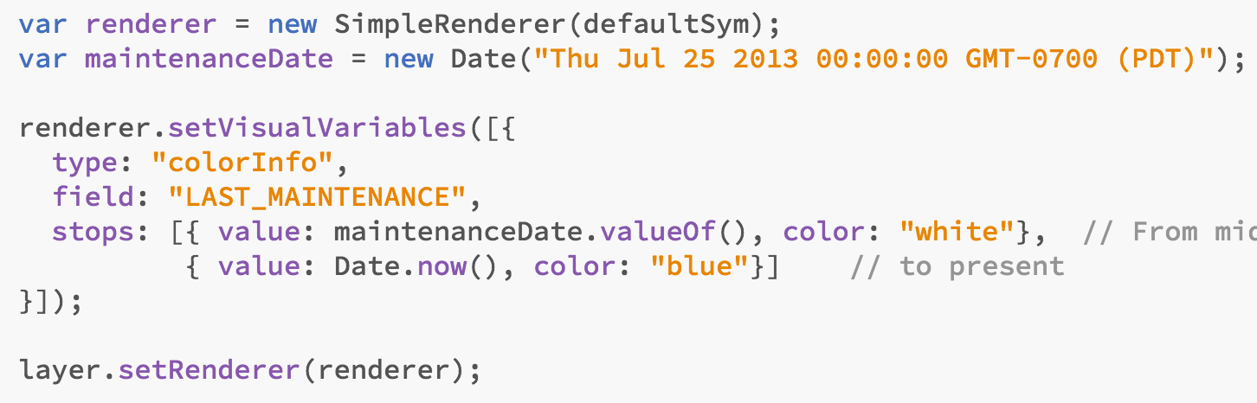
Show me when (timeline continuous color)

Slide 47
Other Renderers
DotDensityRenderer
BlendRenderer
ScaleDependentRenderer
Heatmap
3.x
only

Slide 48
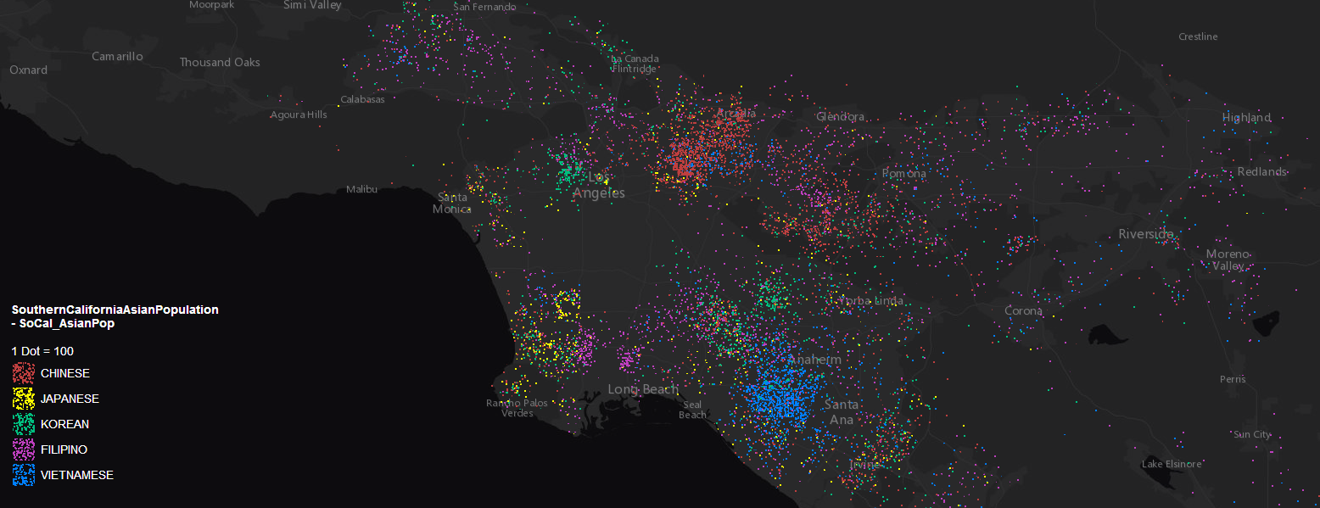
Dot Density
3.x
only
DotDensityRenderer

Slide 49
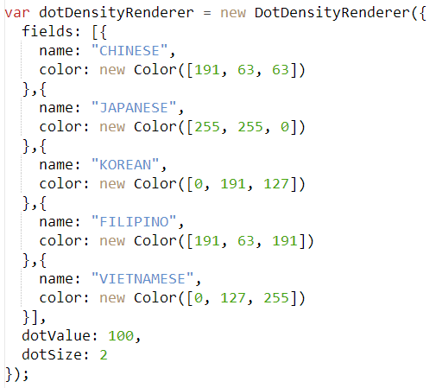
Dot Density
3.x
only
DotDensityRenderer

Slide 50
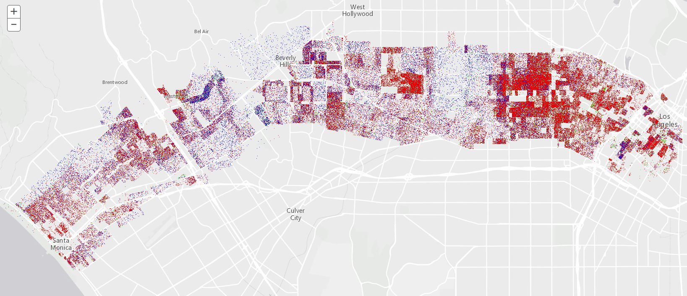
DotDensity can represent 1 dot per value
3.x
only

Slide 51
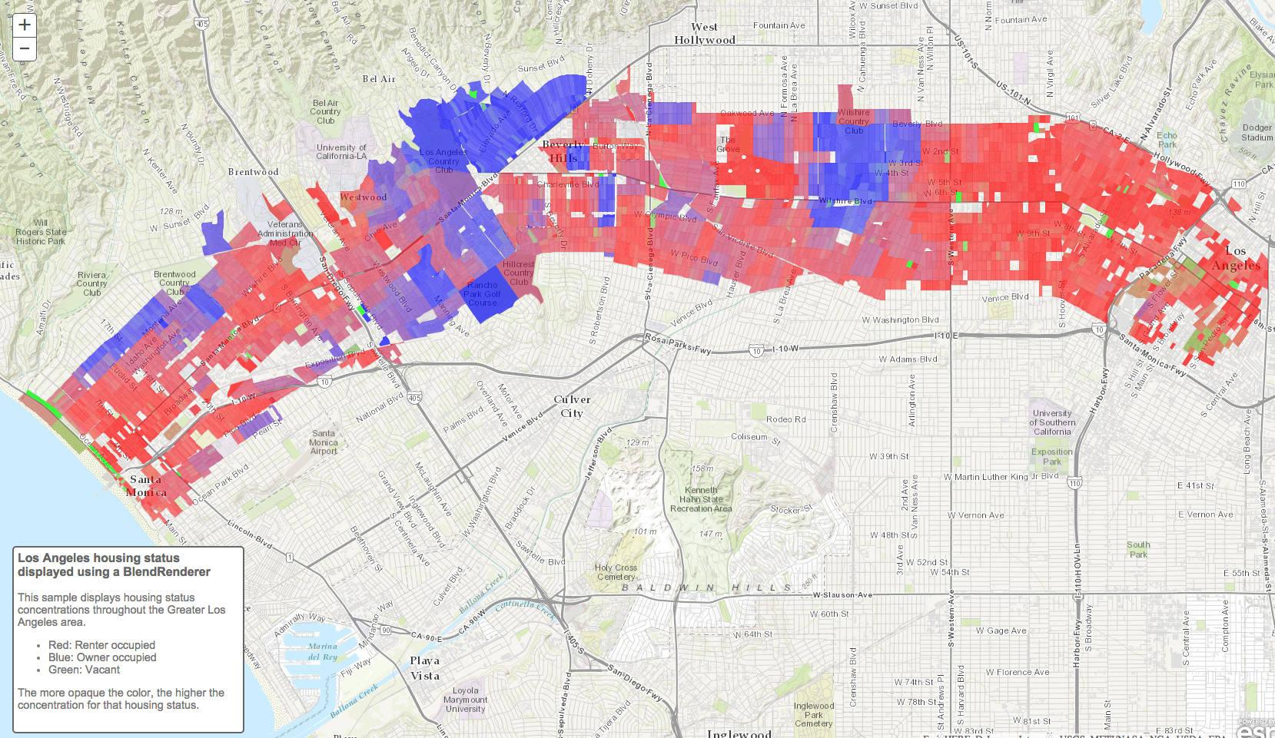
BlendRenderer -- Beta
3.x
only

Slide 52
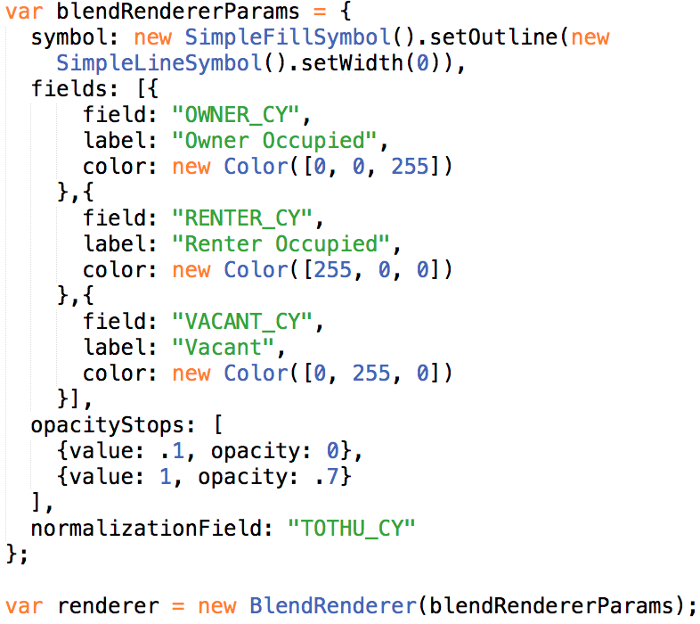
BlendRenderer
3.x
only

Slide 53

3.x
only

Slide 54

Heatmap Renderer
3.x
only

Slide 55
Smart Mapping
4.x
partial
Let your data drive your visualization

Slide 56
Smart Mapping
4.x
partial
Data driven defaults
Introduced in 3.13/4.2
Takes the guesswork out of:
What colors to use…for fill, outline, background fill outline, etc
What opacity to use on each color
What size to use for lines, markers, outlines on markers
What size is appropriate for what scale
Does this by looking at the data, the basemap, and the story you want to tell
Used by authoring and data exploration apps

Slide 57


Smart Mapping API components -- Styles
4.x
partial

Slide 58

Smart Mapping API components – FL Stats Plugin
4.x
partial

Slide 59

Smart Mapping API components – FL Stats Plugin
4.x
partial

Slide 60

Smart Mapping API components – smartMapping
4.x
partial

Slide 61

Smart Mapping API components – smartMapping
4.x
partial

Slide 62

Smart Mapping API components – Sliders
4.x
partial

Slide 63


Smart Mapping API components – smartMapping

Slide 64
Smart Mapping
4.x
partial
Goal is to help you generate the best possible visualization for your data
It is expensive to introspect your data
Best option is to let SmartMapping generate you a renderer that you use in your application statically.
The authoring experience of ArcGIS.com uses smart mapping in WebMaps

Slide 65






Please Take Our Survey!
Scroll down to the
“Feedback” section
Download the Esri Events app
and go to DevSummit
Select the session you attended
Complete Answers,
add a Comment,
and Select “Submit”

